Slide 1
Campus Area Network (CAN)

Slide 2
Team Members
Joseph George Wahba
Menna-Allah Ahmed
Abdelhalim Ramadan
Zeyad Muhamed Yehya

Slide 3
Table of contents
1
2
3
5
Abbreviations
Introduction
Project
Phases
4
6
Challenges &
& solutions
Future Enhancements
Conclusion

Slide 4
01
Abbreviations

Slide 5
Abbreviations
OSPF : Open Shortest Path First
HSRP : Hot Standby Router Protocol
STP : Spanning Tree Protocol
DHCP : Dynamic Host Configuration Protocol
DNS : Domain Name System
FTP : File Transfer Protocol
NTP : Network Time Protocol
Syslog : System Logging Protocol
ACL : Access Control List
VLAN : Virtual Local Area Network
IP : Internet Protocol
NGFW : Next-Generation Firewall
IDS : Intrusion Detection System
SDN : Software-Defined Networking
DMZ: A Demilitarized Zone

Slide 6
2
Introduction

Slide 7
Project overivew
Campus Network Project :
A scalable three-layer design with VLAN segmentation, redundancy protocols (HSRP(Hot Standby Router Protocol), STP(Spanning Tree Protocol)), and secure IP addressing to simulate a robust enterprise campus network.
Key goals to achieve
Scalability
Availability
Security

Slide 8
3
Project phases

Slide 9




Project phases
Network design
Network secuirty
Core implementation
Testing & Optimization

Slide 10
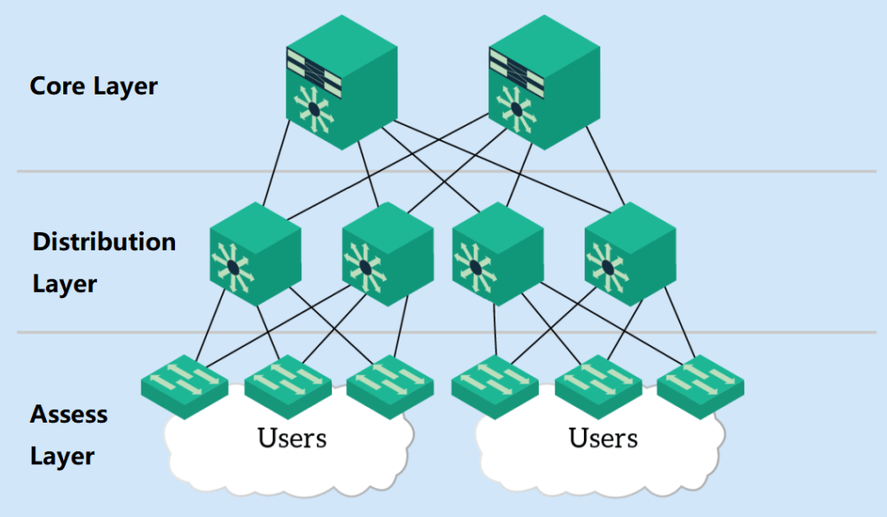

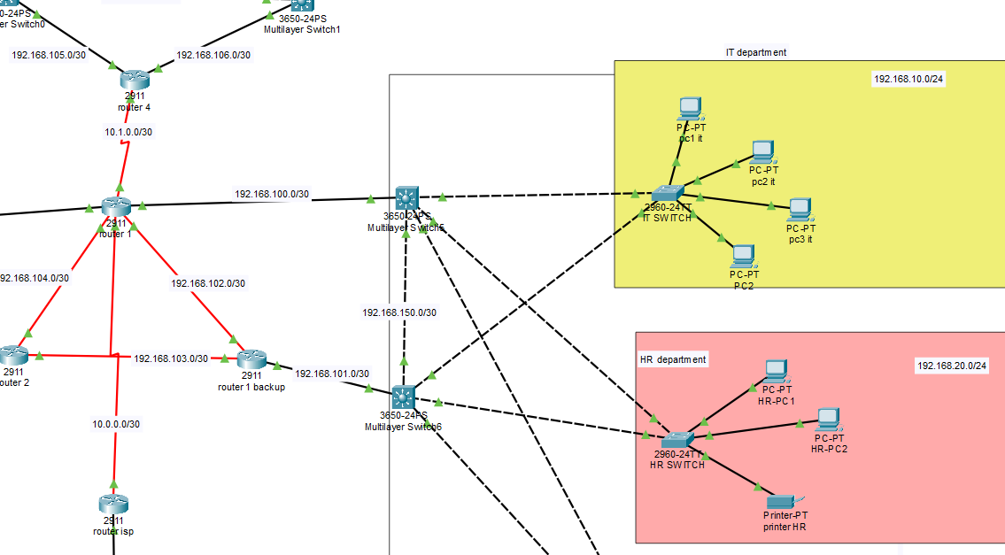
Network design
Network design structures a network for efficient, secure communication. It uses a three-layer model:
Core (fast backbone)
Distribution (routing/control)
Access (user connection)
This ensures performance, scalability, and easy management.

Slide 11
Devices used
PCs
User devices for accessing network services
Multilayer switches
Combine switching and Inter Vlan routing .
access switches
Connect local devices in the access layer
routers
Link different networks and manage traffic
Servers
Provide shared services (e.g., files, web)

Slide 12
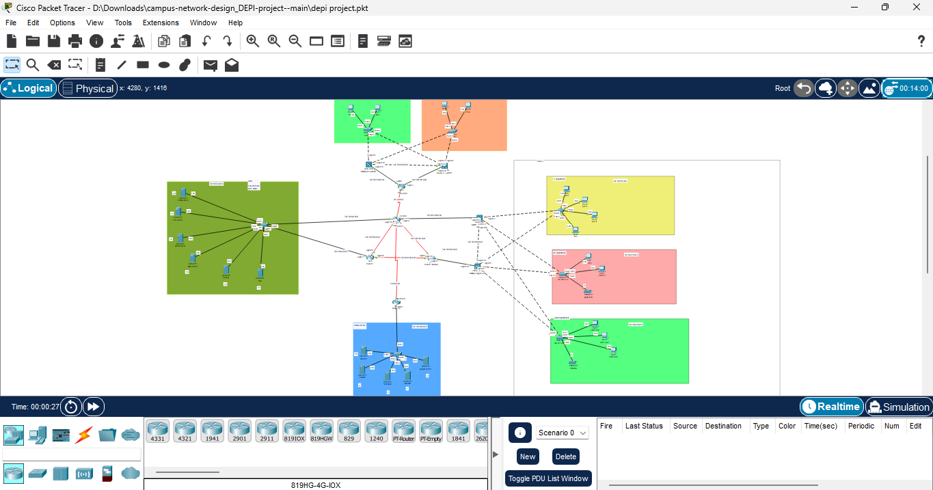
Full network Toplogy

Slide 13
Vlans and thier subnets
Core Implementation
 | Network | Subnet mask | Defult gateway
IT | 192.168.10.0/24 | 255.255.255.0 | 192.168.10.1
HR | 192.168.20.0/24 | 255.255.255.0 | 192.168.20.1
Sales | 192.168.30.0/24 | 255.255.255.0 | 192.168.30.1
Management | 192.168.40.0/24 | 255.255.255.0 | 192.168.40.1
Health & care | 192.168.50.0/24 | 255.255.255.0 | 192.168.50.1

Slide 14



Why we used both Dynamic OSPF (Open Shortest Path First) (Open Shortest Path First) & Static Routing ? To combine between the advantages of the two routing :
Core Implementation
Static routing advantages
Simple to configure manually
Consumes fewer resources
Dynamic routing advantages
Adapts to network changes
Scales for large networks

Slide 15
Servers used in the project :
DHCP
(Dynamic Host Configuration Protocol)
Automatically assigns IP addresses to devices, easing network management.
Email
Handles sending, receiving, and storing of organizational email traffic.
Syslog
Collects logs from network devices for monitoring and diagnostics.
FTP
(File Transfer Protocol)
Enables file transfers between systems for sharing and centralized storage.
Keeps device clocks Aligned across the network for accurate timing.
Translates domain names into IP addresses for easier access to services.
NTP
(Network Time Protocol)
DNS
(Domain Name System)

Slide 16
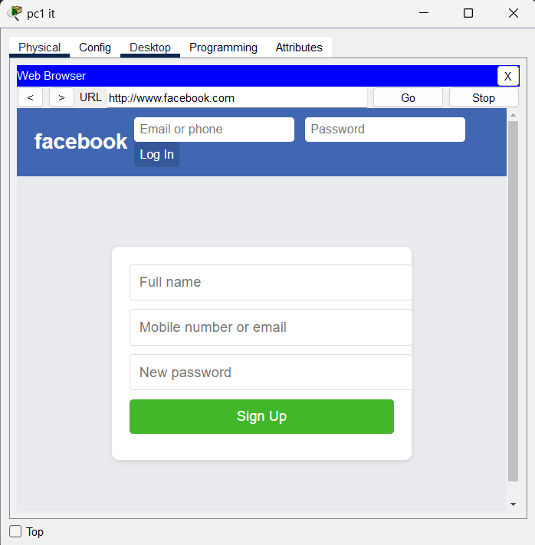
EX of Servers used in the project :

Slide 17

Port security
Port security is a Layer 2 feature that restricts switch port access using MAC addresses. It prevents unauthorized devices from joining the network . Limiting allowed devices per port enhances local access control . It also protects against MAC flooding and spoofing attacks.
Why Using Port Security
Prevents unauthorized device access
Limits number of devices per port
Provides alert or shutdown options on violation

Slide 18

Testing in Network Design
Testing:
tested all device configurations IP addressing , VLANs ,(etc).
Simulated network traffic to ensure stable connectivity.
Verified access between PCs and servers to catch issues early.
Failover:
Implemented redundancy using multiple links and backup paths.
Used multilayer switches for faster internal failover.
Ensured the network stays active during device or link failure.

Slide 19
4
Challenges & solutions

Slide 20

Challenges & Soultions
Scalability → Used VLANs and OSPF (Open Shortest Path First) for easy expansion.
Broadcast Traffic → VLANs reduced unnecessary broadcasts.
Redundancy → HSRP(Hot Standby Router Protocol) and STP(Spanning Tree Protocol) ensured backup paths.
Security → Used ACLs (Access Control List) and VLANs to protect data.
Monitoring → Syslog server helped with centralized logging.

Slide 21
5
Future Enhancements

Slide 22
Future Enhancement
Stronger Security
Add NGFW(Next-Generation Firewall) ,IDS (Intrusion Detection System) for advanced threat protection.
Network Automation
Use tools like Python for config and monitoring.
Cloud Integration
Connect to AWS (Amazone web server) for storage & scalability.
SDN Implementation
Introduce SDN (Software-Defined Networking) for smarter traffic control.
AI & ML Integration
Use AI/ML for anomaly detection and performance tuning.

Slide 23
6
Conclusion

Slide 24
Project overview
Campus Area Network (CAN) Design Highlights
Performance & Growth
Easy to manage & scale
Ready for future needs
Fast and stable
connectivity
Network Security
Blocks unauthorized access
ACLs applied
Secures VLAN communication
Redundancy & Uptime
Ensures continuous service
HSRP and STP for failover
Supports seamless failover for critical services.

Slide 25
Thank YOU

